Slide 1
poto
of rimary
Joshua T. Vogelstein
Data Science Core
Joshua T. Vogelstein, Randal Burns
Consult on ”best practices” for all data science activities for the U19
Manage multi-scale atlas
Make all reference data open access according to FAIR principles
Make all data science software tools open source according to FIRM principles
Ben Falk Daniel Tward Devin Crowley Vikram Chandrashekhar

Slide 2
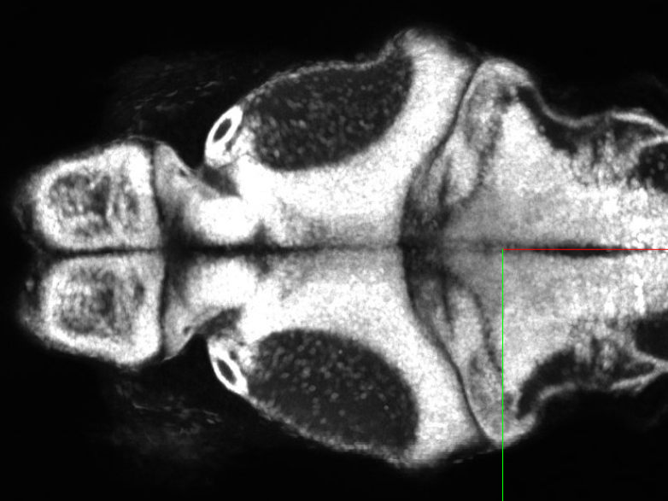
photo
of primary
Joshua T. Vogelstein
Multiscale Atlas
Joshua T. Vogelstein, Ben Falk, Devin Crowley, Daniel Tward, Randal Burns
All three scales available to visualize today at https://neurodata.io/project/zebromes/
Nanoscale infrastructure supports petabytes
Integrated overlays of micro and macro scales
Up next: Overlays of all 3 scales

Slide 3
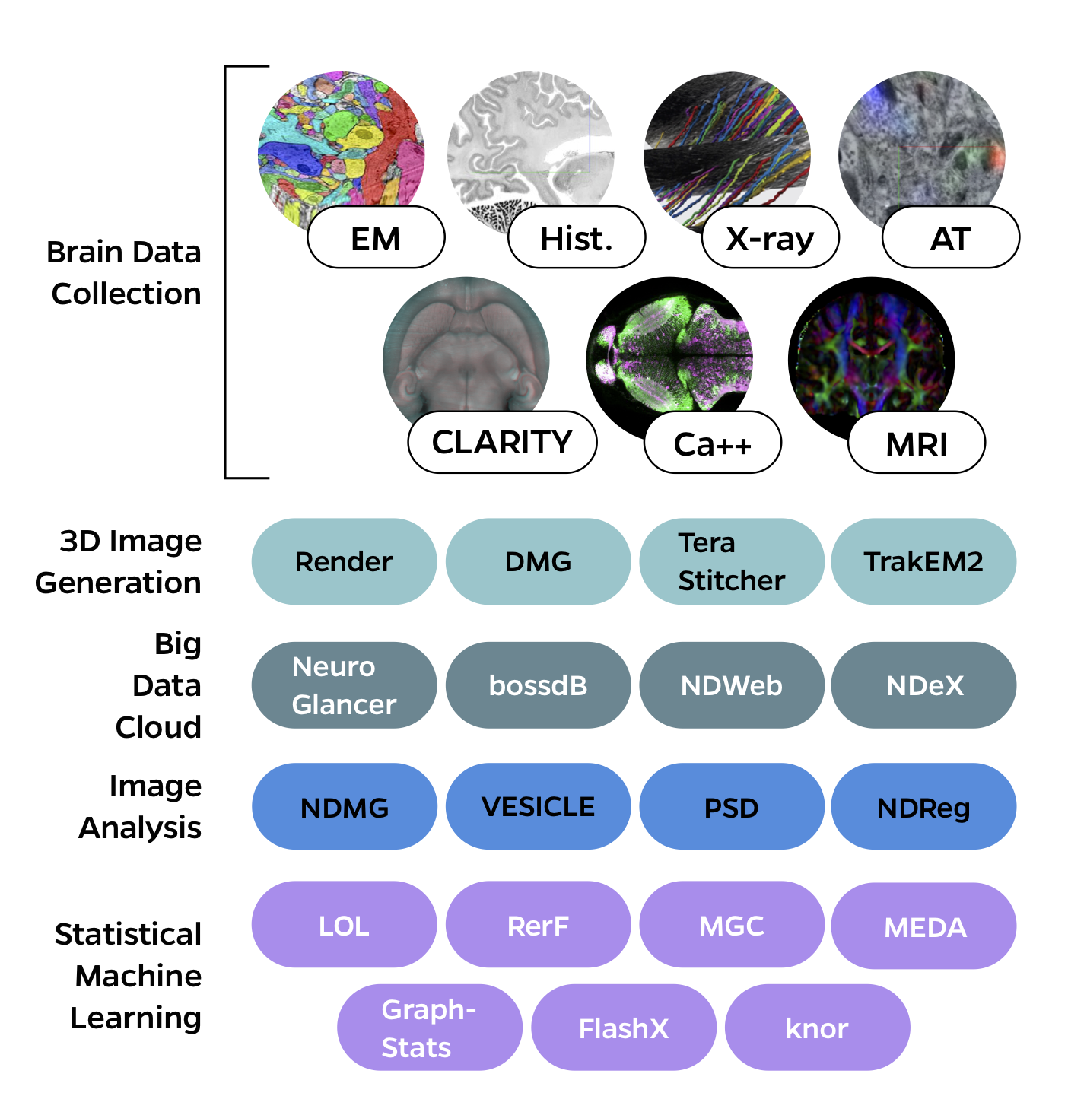
poto
of rimary
Joshua T. Vogelstein
NeuroData’s Cloud Ecosystem to Support Petabyte Multiscale Atlas
Ben Falk, Joshua T. Vogelstein, Randal Burns
Over 10 years of development
Hosts 30+ open access datasets from 20+ labs
Collaborative development with Google, JHUAPL, Allen, Princeton
Largest and most diverse open access brain imaging repository
Only multiscale brain imaging repository
Pub: Nature Methods, 2018
Code: https://neurodata.io/ndcloud/
Live demo
Up next: distributed database, see #25

Slide 4
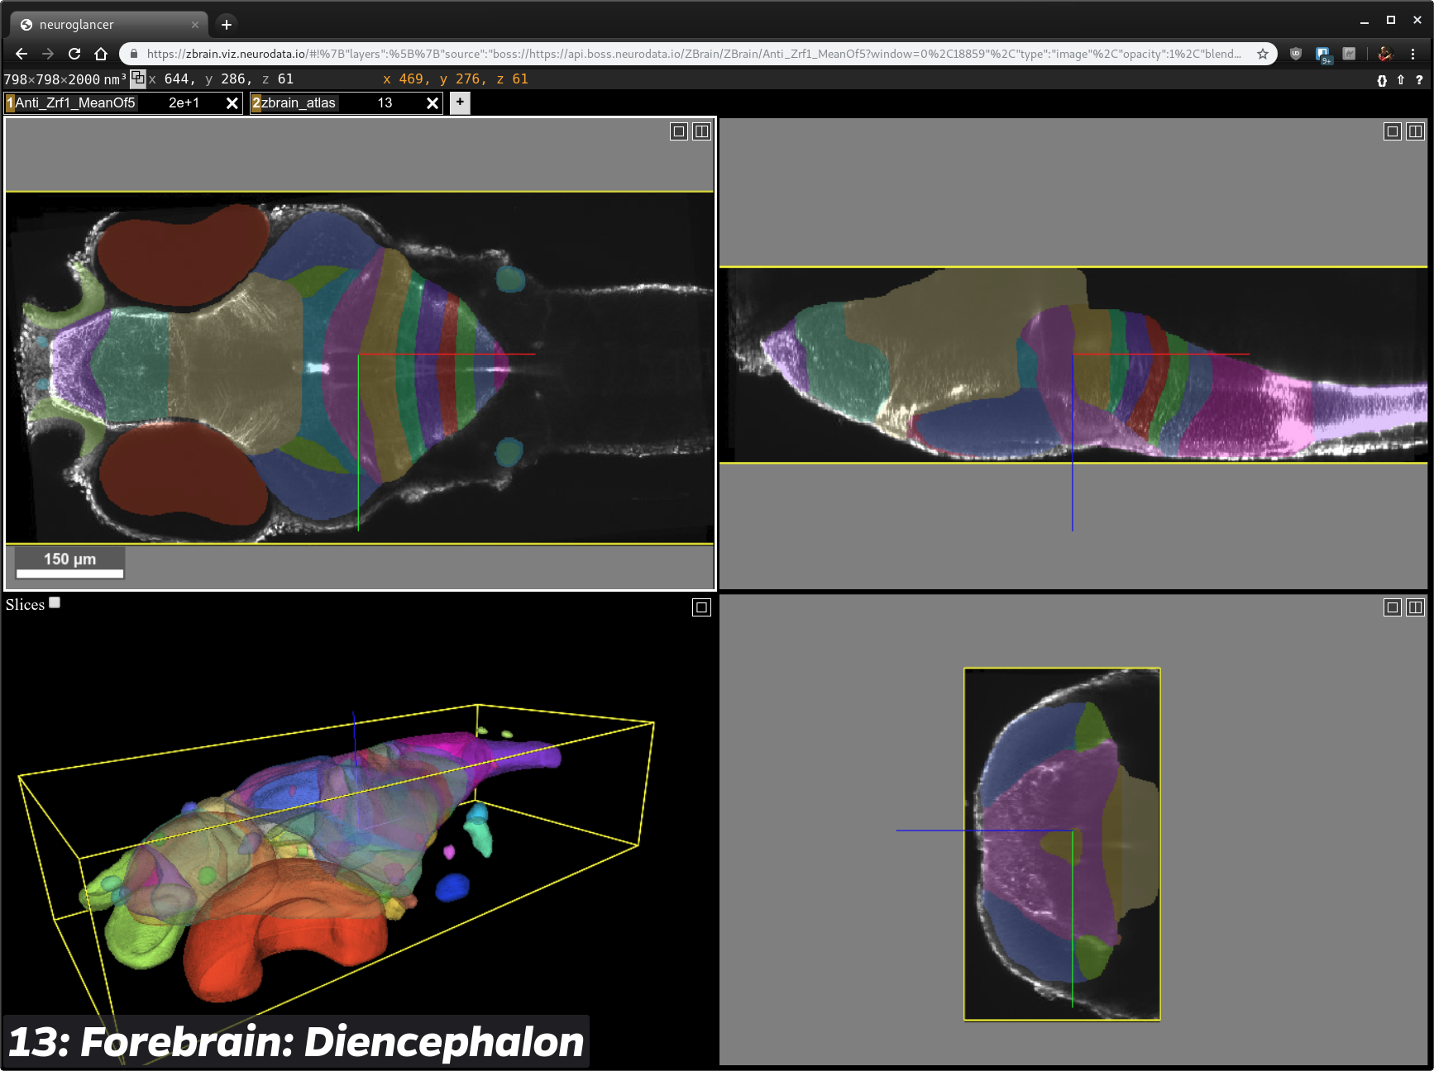
photo
of primary
Joshua T. Vogelstein
Registering Microscale to Macroscale
Devin Crowley, Vikram Chandrashekhar, Daniel Tward, Joshua T. Vogelstein
3D nonlinear diffeomorphic registration
Fully invertible
Missing data, artifacts, multimodal, cross-contrast
Easy to install/use, native python
GPU support to speed up
Pub: bioRxiv, 2019
Code: https://neurodata.io/reg
Live demo
Up next: Nano → Micro, see #45

Slide 6
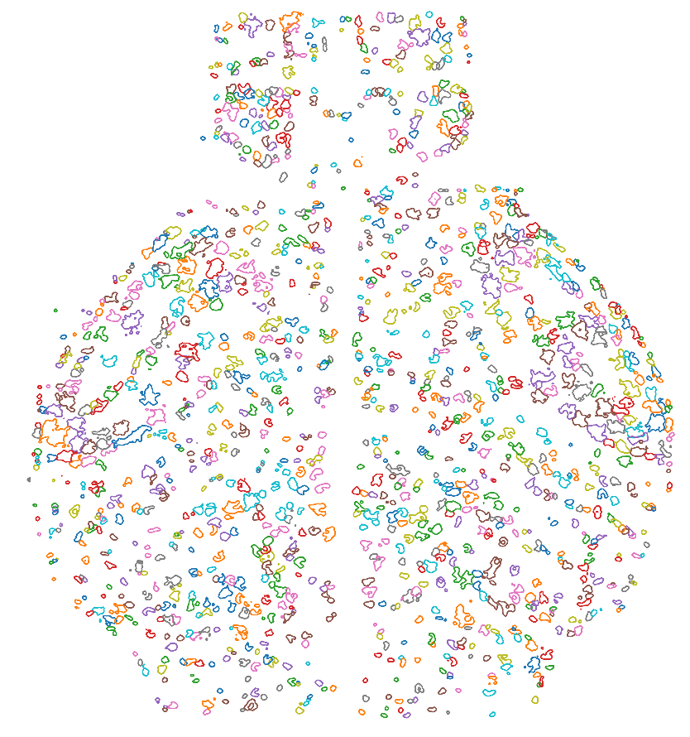
photo
of primary
Joshua T. Vogelstein
Detecting Cell Bodies and Spikes from Calcium Imaging
Joshua T. Vogelstein, David Greenberg
Publications
Code
Established particle filtering time-series methods to capture nonlinear dynamics in calcium
Established non-negative methods for spike and cell detection
Open source derivatives of MATLAB code from 2010 are the de facto standard
Recent extensions to GCamPs
Pub: bioRxiv, 2019
Code: https://github.com/flatironinstitute/CaImAn

Slide 7
photo
of primary
Joshua T. Vogelstein
Modeling Whole Brain Dynamics using EM Constraints
Joshua T. Vogelstein, Cencheng Shen, Sambit Panda
Publications
Code
Must estimate connectivity from activity
Linear univariate methods inadequate
Developed nonlinear multivariate methods
Pub: eLife, 2019
Code: https://neurodata.io/mgc
Up next: validating estimates with EM

Slide 8
photo
of primary
Joshua T. Vogelstein
References
Publications | Link/Code
NeuroData Cloud Ecosystem, Nature Methods (’18) | https://neurodata.io/ndcloud
3D Diffeomorphic Registration, PLoS CB (‘18) | https://neurodata.io/reg
Calcium Imaging, bioRxiv (‘18) | https://github.com/flatironinstitute/CaImAn
Detecting multivariate relationships, eLife (‘19) | https://neurodata.io/mgc
Connectal Coding, Curr. Opin. Neuro. (’19) | https://neurodata.io/graspy
Multiscale Atlas | https://neurodata.io/project/zebromes/

Slide 9
photo
of primary
Joshua T. Vogelstein
Questions?
Questions?

Slide 10
Extra Slides

Slide 11
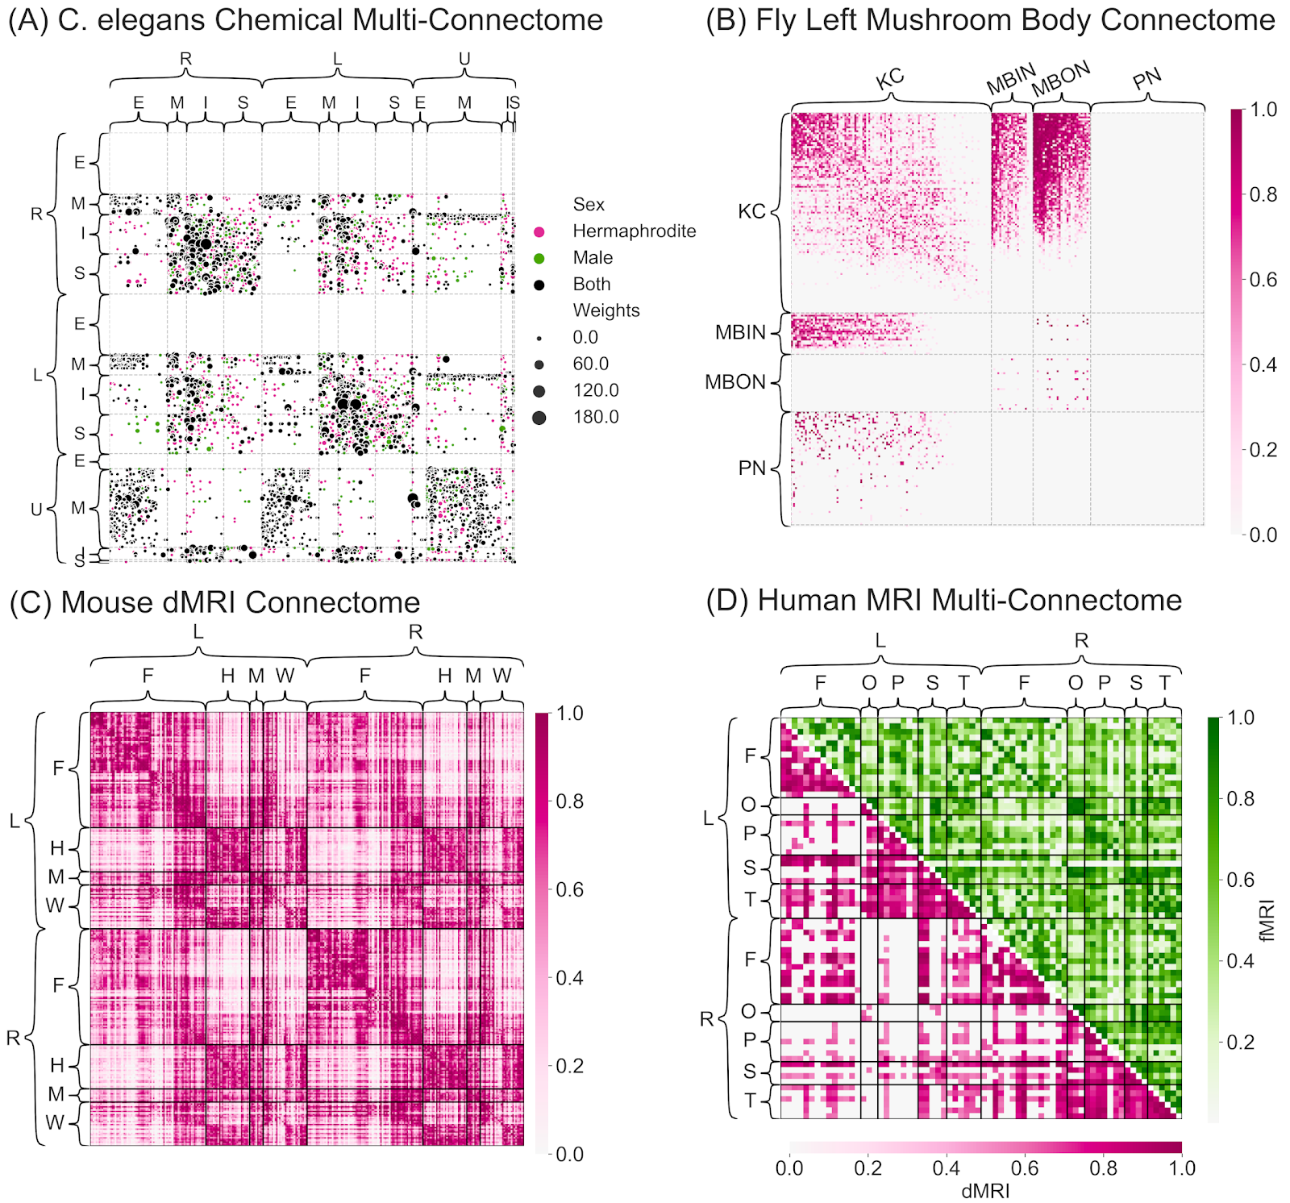
photo
of primary
Joshua T. Vogelstein
Learning the principles governing neural connectivity and its relationship to behavior
Joshua T. Vogelstein, Eric W. Bridgeford, Benjamin Pedigo, Jaewon Chung, Carey E. Priebe
Publications
Code
Statistical generative models of connectomes
Increasing levels of complexity and detail
Estimation provably accurate
Implementation scales to large connectomes
Learning cell type / region specific rules
Which subset of those properties govern connectivity
Input:
1. EM connectivity
3. cell type, location
Output:
principles

